Slide 1
Software Engineering 101
Daniel Goudie
Software Engineer, Union Pacific Railroad

Slide 2
WHO am I?
Software Engineer @ Union Pacific (since 2016)
Grew up here around Elmwood / Murdock
  Graduated 2014 (I’m old and bald, I know.)
Attended University of Nebraska – Omaha ( 2014 → 2018)
  Bachelor’s Degree in Information Assurance (now the program is named “Cybersecurity”)
  Great university for all things technology-related.
Brooke’s brother.
Fun-ish fact: Won FBLA state and went to nationals in 2014 – Website Design
http://bedandbreakfastwillowlake.weebly.com/

Slide 3
What do I do?
Play video games while I’m supposed to be working.
Kidding, I:
  Design and build systems & apps that help UP other employees do their job faster.
    Most of these systems take the form of web applications (websites)
  Write lots of code, mainly Java and JavaScript.
    I also know a little Python & Rust.
  I work on a team of ~5 UP-employed engineers and ~5 contracted engineers (on/offshore)
  Build software tools that other teams at UP use.
  Review APIs created by other teams and provide feedback.

Slide 4
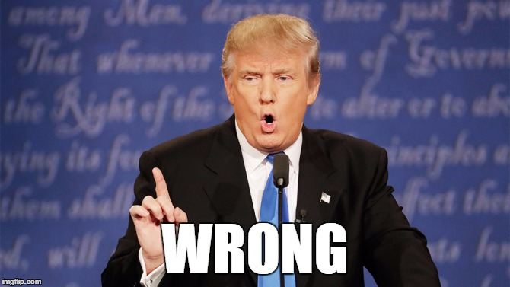
Bored already?
Why I love my job:
  I get to be creative. I create intellectual property for a living.
  Zero monotony. Never did the same thing as the day before in 7 years.
  Very relaxed lifestyle; ultimate flexibility.
    Work whenever I want, leave whenever I want. Work from home.
  Solve complex problems all day. Always new things to learn. Keeps brain fresh.
  Unrivaled pay / benefits
    Start at $80k/yr. Senior engineers can make $150k-$200k or more. Before benefits.

Slide 5
How to prepare?
Computer Science is the best, other programs can work.
  LOTS of math and programming, but will prepare you the best
Cybersecurity was OK.
  Much more interesting IMO. Much broader scope of curriculum.
Get an internship. Best way into a full-time job.
Practice on your own. 90% of what I know was self-taught.
  As you’d expect, every resource you need is available online for free.
Math is (kind of) important.
  Algebra? Definitely need it. Calc? Sometimes.
  Don’t shy away if you’re not Isaac Newton, it’s not that deep.

Slide 6
Worst parts?
The beginning is tough and can seem pointless.
Sedentary lifestyle. Gotta go to the gym.
Don’t be antisocial, because it’s easy to be.
  I sometimes go days without talking to anyone, because I don’t always need to. Gotta make the effort.
A bit mentally draining some days.
  Could be worse, IMO.
BUT:
  The pros far outweigh the cons. And it’s not close.
  “Software Engineer” might seem daunting, it’s not. You CAN kill it if you put your mind to it. There’s a world of opportunity right now.

Slide 7
Ask questions. Thanks.

